Slide 1
A Study Of The Book Of Revelation
May 16, 2021

Slide 2
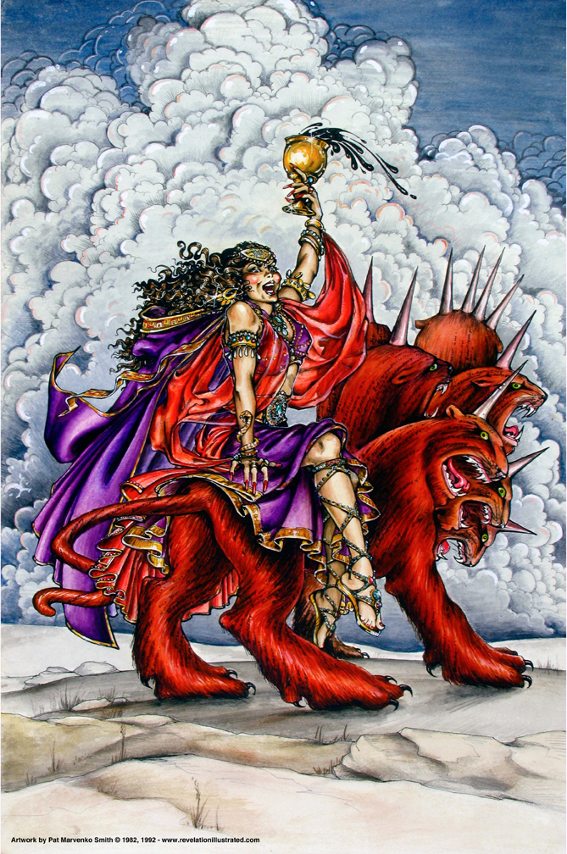
The Book of Revelation: Chapter 17
Scarlet Woman Upon
the Scarlet Beast

Slide 3
Resources used:
A Study Of The Book Of Revelation by Bob Dodson
More Than Conquerors by William Hendriksen
Overcoming With The Lamb, Florida College Annual Lectures, February 7-10, 1994
Revelation: An Introduction and Commentary by Homer Hailey
Revelation (Truth Commentaries) by Robert Harkrider
Revelation (A Study Workbook) by Robert Harkrider
Revelation by Donnie Rader
Revelation charts by Keith Greer.
Studies In The Book Of Revelation by Ferrell Jenkins
The Apocalypse of St. John by Henry Barclay Swete http://biblicalstudies.gospelstudies.org.uk/pdf/e-books/swete_h-b/apocalypse-of-st-john_swete.pdf (540 pages)
The Old Testament In The Book Of Revelation by Ferrell Jenkins
The Revelation Of Saint John The Divine by G.B. Caird
The Book of Revelation by Foy E. Wallace
The Avenging of the Apostles and Prophets by Arthur M. Ogden
Worthy Is The Lamb by Ray Summers
Written exchange on “The Domitian Persecution” between Arthur M. Ogden and Ferrell Jenkins presented in Searching The Scriptures, June 12, 1989, pages 7-12

Slide 4
Revelation
I. Struggle on Earth (1-11)
A. John’s Vision (1)
B. Letters to 7 churches (2-3)
C. God in control (4-5)
D. Opening of seven seals (6-11)

Slide 5
Revelation
II. Christ And The Dragon In Conflict (12-22)
(Deeper Spiritual Meaning)
A. War (12-14)
B. Bowls of Wrath (15-16)
C. Fall of Babylon the Harlot (17-18)
D. Victory of God’s people (19-21)
E. Warnings about the Book (22)

Slide 6
Revelation 17
“The Great Harlot”
John’s Vision of the Great Harlot (verses 1-6)
The character of the two women and two cities are prominent in the second section of the book. (Chapters 12-22)
Explanation of the Mystery (verses 7-18)

Slide 7
Revelation 17
“The Two Women and The Two Cities”
In Chapter 12 the woman represented all God’s redeemed ones
In Chapter 17 several positions have been proposed:
Apostate Palestinian Jerusalem, the head of hostile Judaism (Foy E. Wallace, The Book of Revelation)
Apostate church which developed in the centuries following Pentecost.
Some apply this to the Roman Catholic church.
Pagan Rome, which in turn represents the world of lust, all that is evil. (Homer Hailey, Revelation: An Introduction and Commentary, Pages 341-342)

Slide 8
Revelation 17
“The Two Women and The Two Cities”
This section (Revelation 17:1-19:10) falls into three parts:
The harlot and her seductive wiles. (chapter 17)
The judgment and fall of the harlot. (chapter 18)
The hallelujahs of heaven over her fall and the victory of the saints. (19:1-10) (Homer Hailey, Revelation: An Introduction and Commentary, Page 342)

Slide 9
Revelation 17

Slide 10

Revelation 17:1
Revelation 17:1-5
“And there came one of the seven angels that had the seven bowls, and spake with me, saying, Come hither, I will show thee the judgment of the great harlot that sitteth upon many waters”

Slide 11
Revelation 17:2
Revelation 17:1-5
“with whom the kings of the earth committed fornication, and they that dwell in the earth were made drunken with the wine of her fornication.”

Slide 12
Revelation 17:3
Revelation 17:1-5
“And he carried me away in the Spirit into a wilderness: and I saw a woman sitting upon a scarlet-colored beast, full of names of blasphemy, having seven heads and ten horns.”
Revelation 13:1

Slide 13
Revelation 17:4
Revelation 17:1-5
“And the woman was arrayed in purple and scarlet, and decked with gold and precious stone and pearls, having in her hand a golden cup full of abominations, even the unclean things of her fornication”

Slide 14
Revelation 17:5
Revelation 17:1-5
“abomination” (bdelugmaton) = “to be
detestable, loathe, abhor” (Moulton 68). Note: God’s view of the harlot and what she represented was
loathsome, abhorrent, disgusting, and detestable. There is no stronger word for God’s disposition
toward unauthorized practices (see Deuteronomy 7:26)
“and upon her forehead a name written, MYSTERY, BABYLON THE GREAT, THE MOTHER OF THE HARLOTS AND OF THE ABOMINATIONS OF THE EARTH.”

Slide 15
Babylon’s Past
Revelation 17
Pride: Proverbs 16:18, “Pride (goeth) before destruction, And a haughty spirit before a fall.”
Note Context:
Habakkuk 2:4, “Behold, his soul is puffed up, it is not upright in him; but the righteous shall live by his faith.”
Isaiah 14:13-14, “And thou saidst in thy heart, I will ascend into heaven, I will exalt my throne above the stars of God; and I will sit upon the mount of congregation, in the uttermost parts of the north; I will ascend above the heights of the clouds; I will make myself like the Most High.”
Isaiah 47:7, “And thou saidst, I shall be mistress for ever; so that thou didst not lay these things to thy heart, neither didst remember the latter end thereof.”
cf. Isaiah 13:11, “And I will punish the world for (their) evil, and the wicked for their iniquity: and I will cause the arrogancy of the proud to cease, and will lay low the haughtiness of the terrible.”
Isaiah 13:19, “And Babylon, the glory of kingdoms, the beauty of the Chaldeans’ pride, shall be as when God overthrew Sodom and Gomorrah.”

Slide 16
Babylon’s Past
Revelation 17
Full of idols.
Jeremiah 50:1-10, 38
Jeremiah 51:17-18, 47, 52
Isaiah 46-47
Isaiah 21:8-9, “And he cried as a lion: O Lord, I stand continually upon the watch-tower in the day-time, and am set in my ward whole nights; and, behold, here cometh a troop of men, horsemen in pairs. And he answered and said, Fallen, fallen is Babylon; and all the graven images of her gods are broken unto the ground.”

Slide 17
Babylon’s Past
Revelation 17
Cruelty in war.
Isaiah 14:4-6
Jeremiah 51:25, 33-35
Habakkuk 1:6-16
Jeremiah 50:10, “‘Chaldea will become plunder;
All who plunder her will have enough,’ declares the Lord.” NASU

Slide 18
The Harlot
Revelation 17
The harlot (mother of harlots) — the object of coming judgment — the sentence is pronounced
In the OT three cities are designated as “harlots” and another as a mistress given to pleasure.
Nineveh. Nahum 3:1, 4
Tyre. Isaiah 23:15-17
Babylon. Isaiah 47:5-15
Israel and Judah. Jeremiah, Ezekiel, Hosea, and Micah
Angel brings the message
Awful harlot in contrast with the bride of Christ
Follows the pouring out of the bowls of God’s wrath
Now will receive some of the “details”

